Slide 1


TELECOM Project
Visualized by David yang

Slide 2
AGENDA
● Executive Dashboard of Call Centre Performance
● Customer Service Dash●board
● Agent Effectiveness
● Call Volumes
● Relative Date on a Special Date
● Last N Report Weeks on a Special Date
● Executive Dashboard on a Special Date
● Telecom Churn Analysis 1
● Telecom Churn Analysis 2.1
● Telecom Churn Analysis 2.2
● Telecom Churn Analysis 3

Slide 3
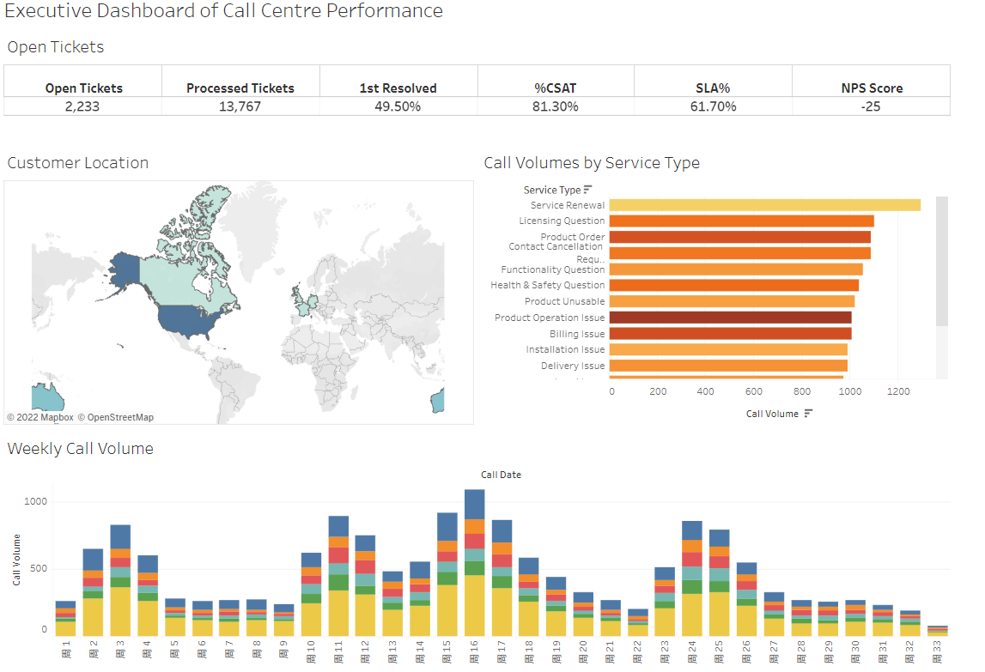
Data validation

Slide 4
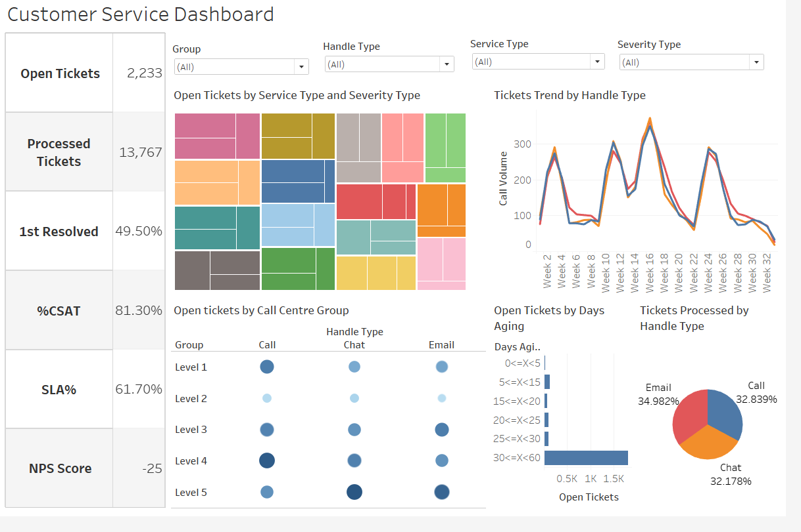

Slide 5
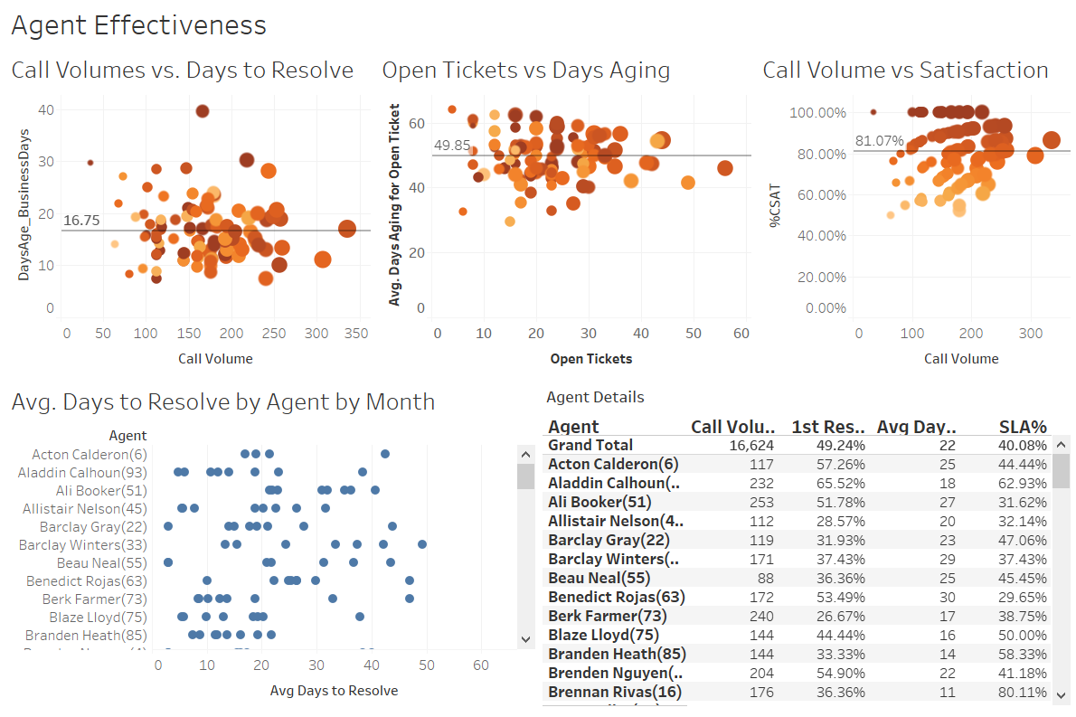

Slide 6
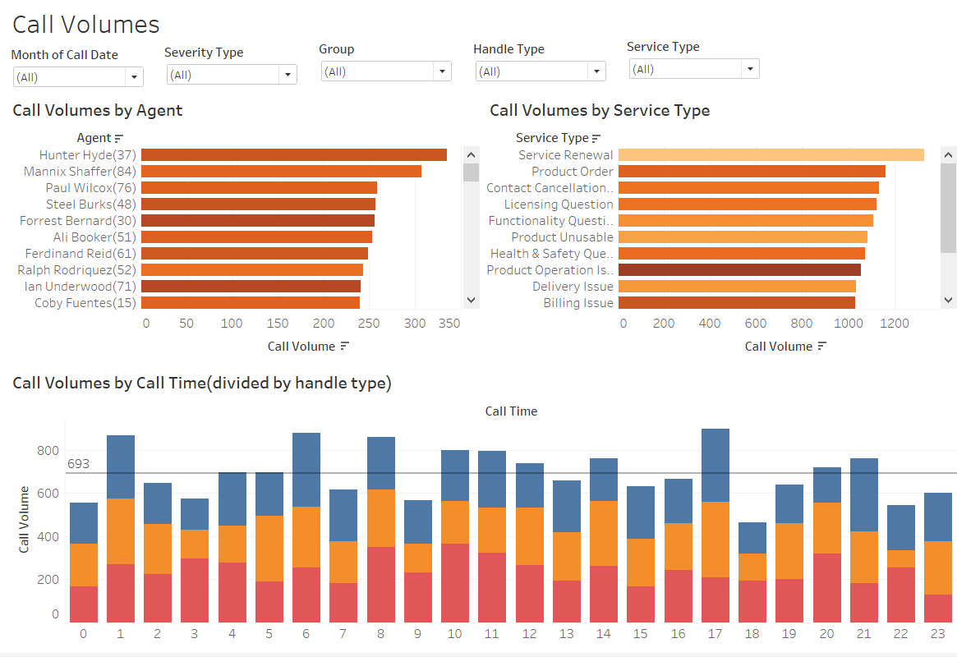

Slide 7
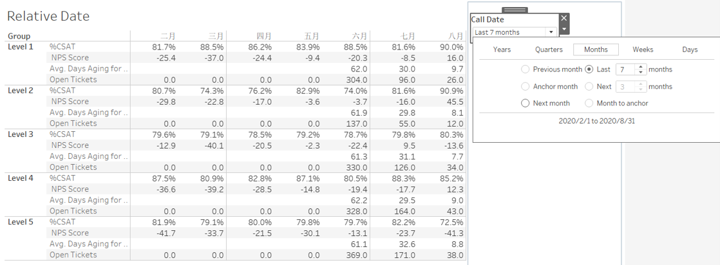
Telecom Data Visualization---Relative Date

Slide 8
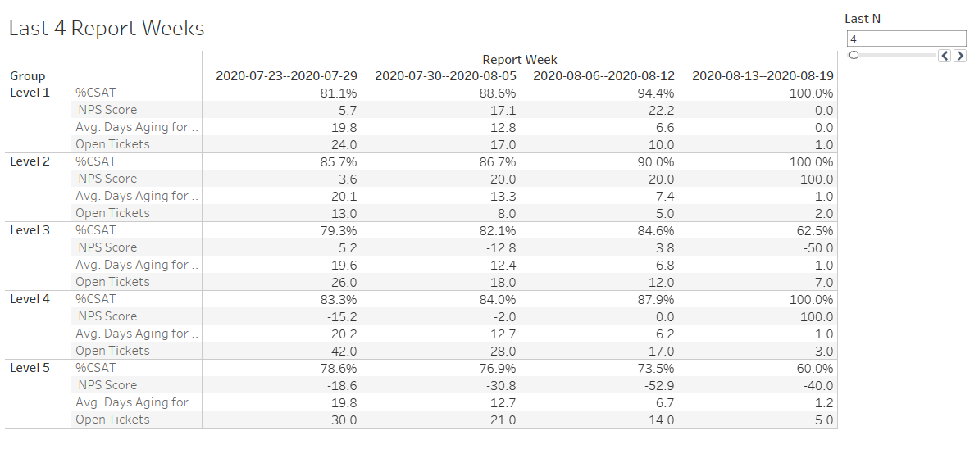
Telecom Data Visualization---Last N Report Weeks

Slide 9
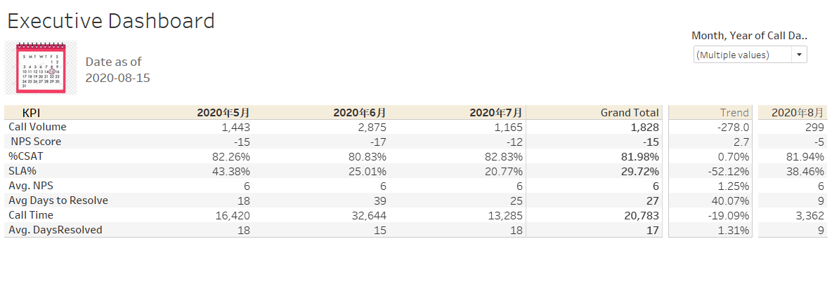
Telecom Data Visualization---Executive Dashboard

Slide 10
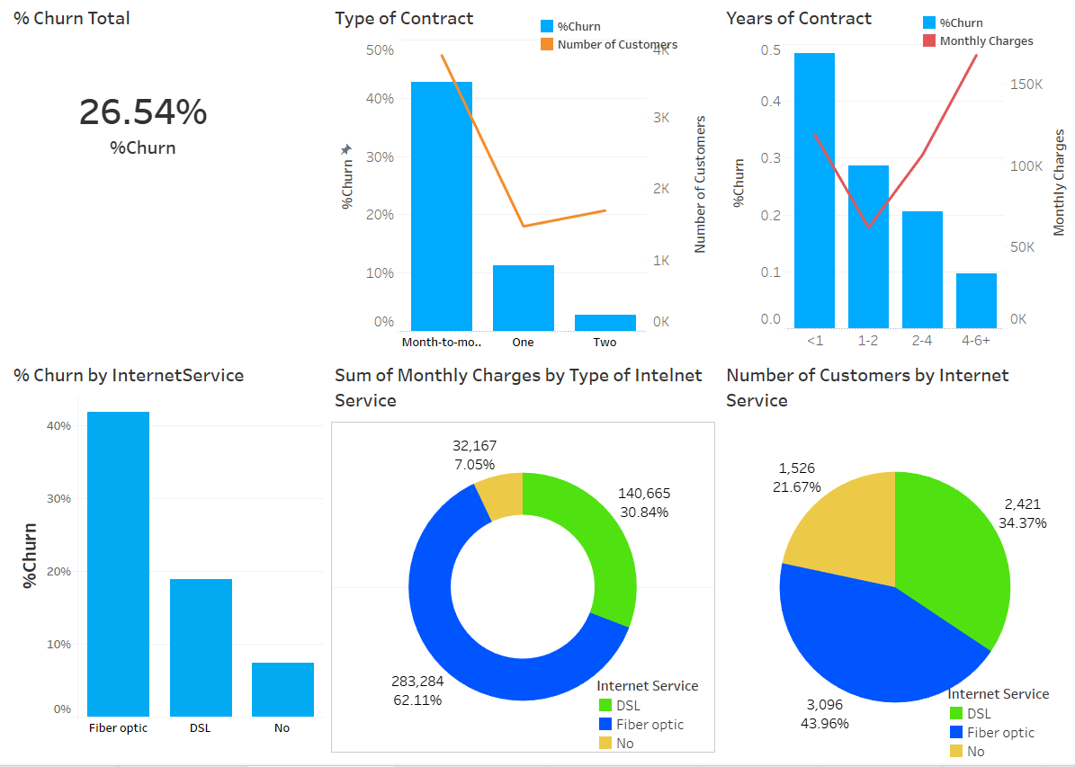
Telecom Churn Analysis 1

Slide 11
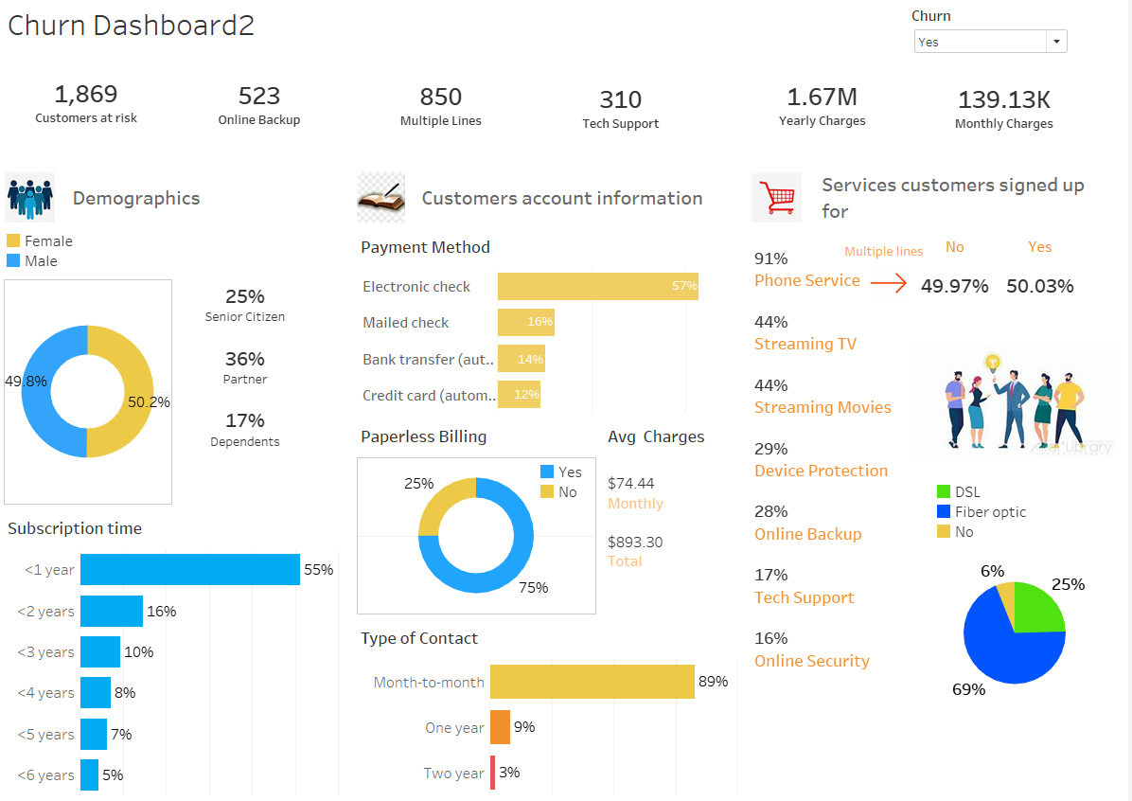
Telecom Churn Analysis 2.1

Slide 12
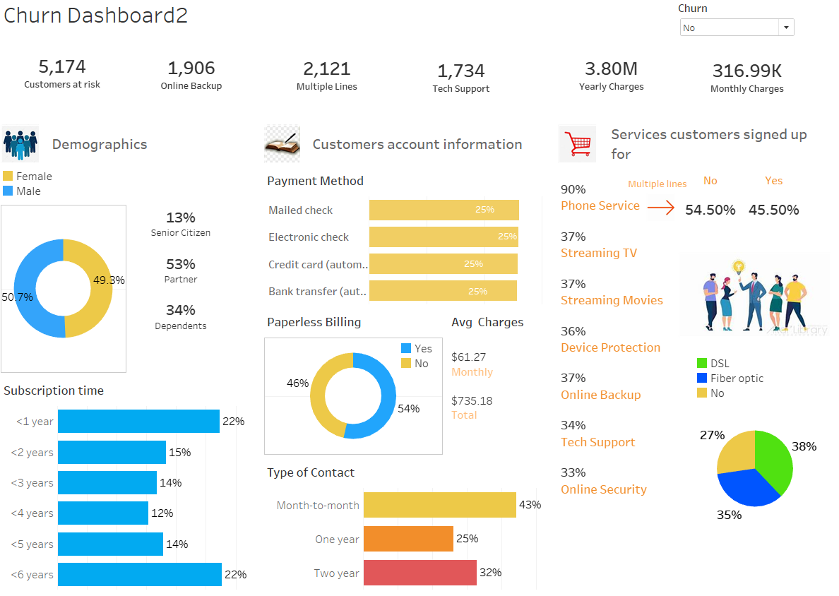
Telecom Churn Analysis 2.2

Slide 13
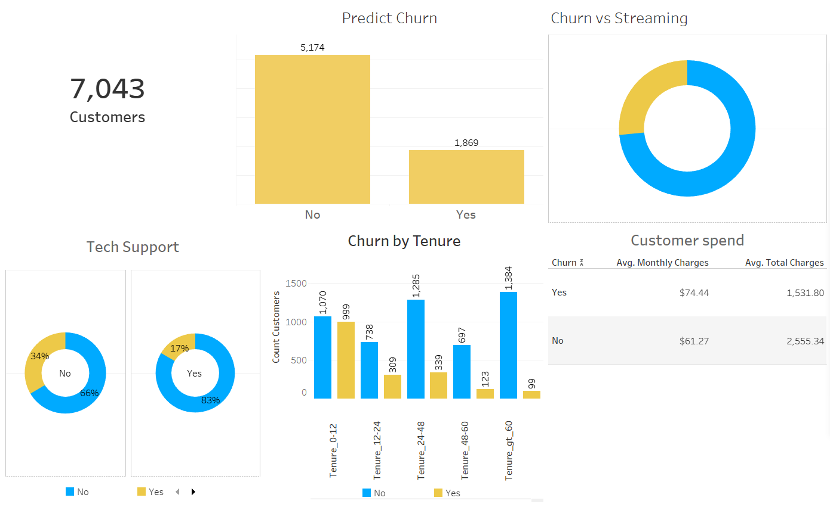
Telecom Churn Analysis 3

Slide 14

Thanks

